Slide 1
Team Members
_________________________ Name: Md Sakhawat Hossain
ID: 383552
Internship

Slide 2
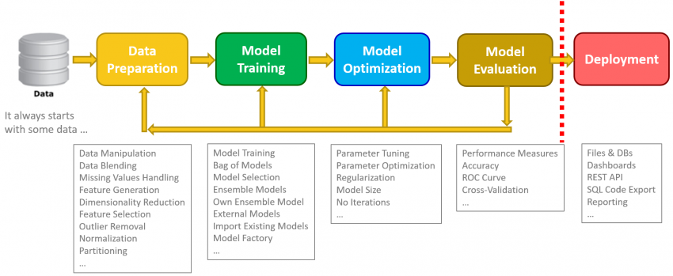
Software Architecture

Slide 3


Technology
For Eda and Model Building:
Jupiter Notebook,
TensorFlow,
Python and It’s library such as Pandas, NumPy, matplotlib, Pandas-Profiling.
For Web Development:
Html, CSS, Python.

Slide 4
Methodology
Data collection
Data augmentation
CNN for Classification
Experiment setup
Performance evaluation

Slide 5
Data collection
Dataset was collected from Kaggle

Slide 6
Data Augmentation
As monkeypox is new disease we got 279 related images.
Keras image processing library such as ImageDataGenerator is used to augment the dataset.
ImageDataGenerator function provides various options such as: rotation, width and height shifting, and flipping.

Slide 7
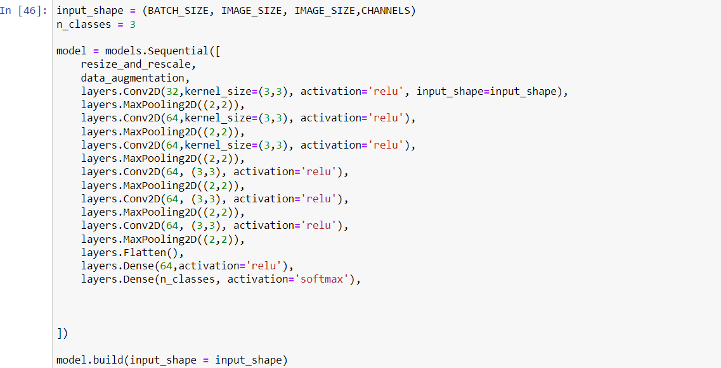
Model Build
Number of Classes = 3
Class = ( Monkeypox, Measles, Normal images)
Batch Size = ( 32, 256, 256, 3 )
Epoch = ( 30, 50, 100, 200 )

Slide 8
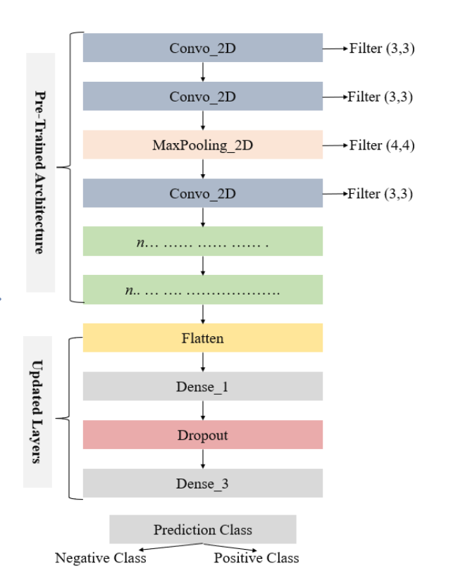
Model Sequential

Slide 9
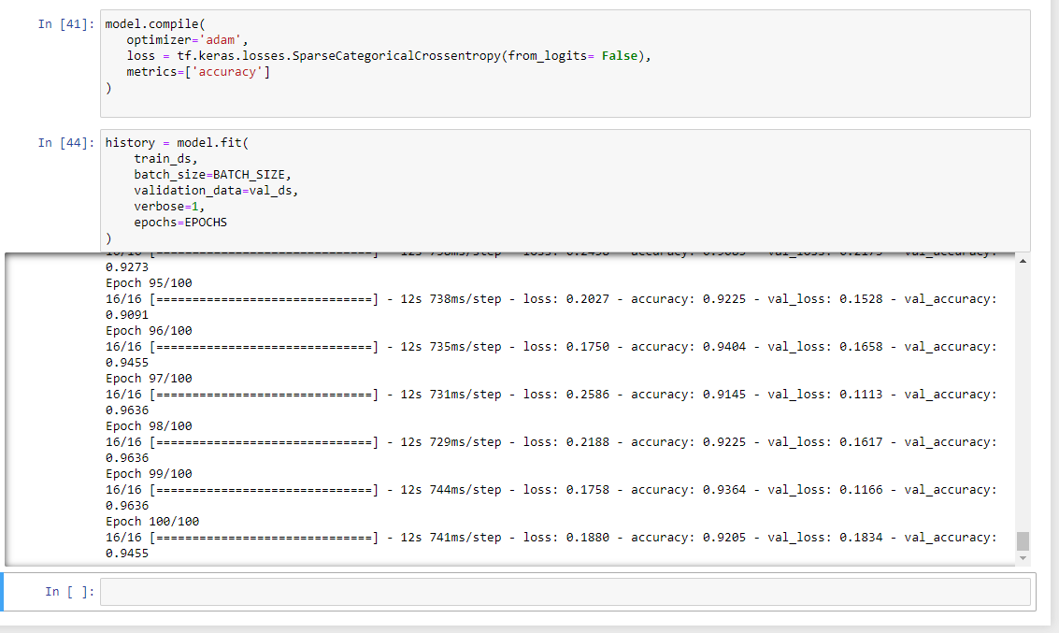
Model Compile

Slide 10
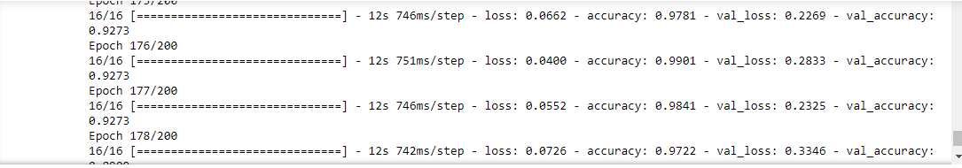
Performance

Slide 11
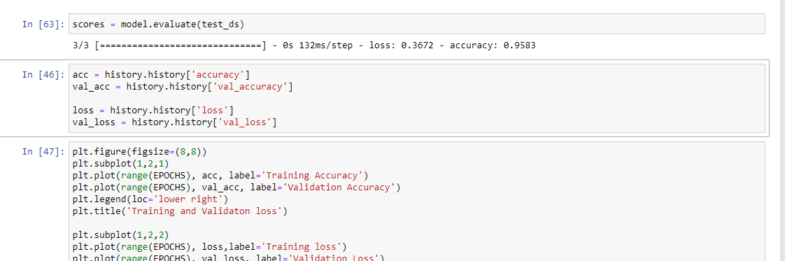
Model Evaluation

Slide 12
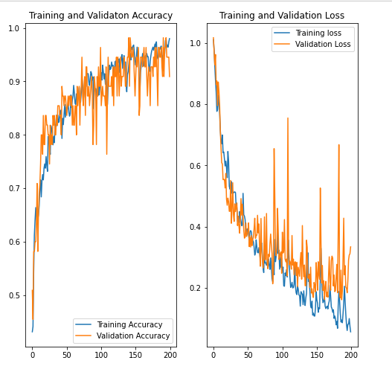
Curve

Slide 13
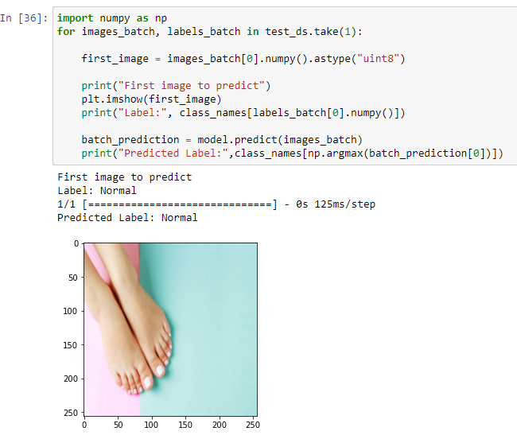
Testing sample

Slide 14
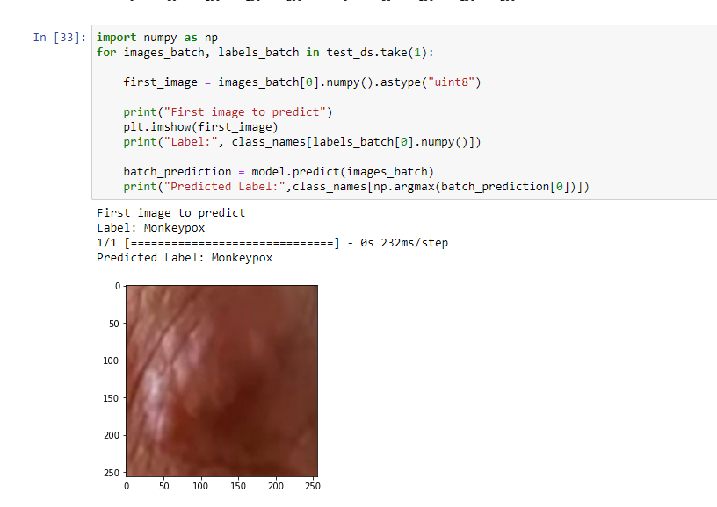
Testing sample

Slide 15
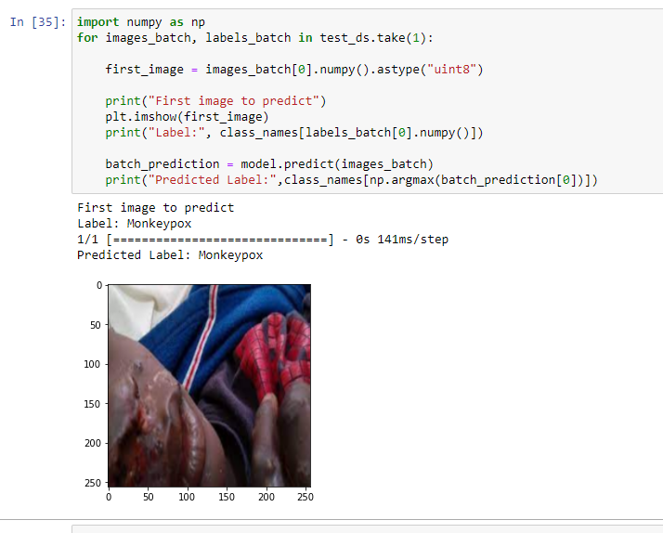
Testing sample

Slide 16
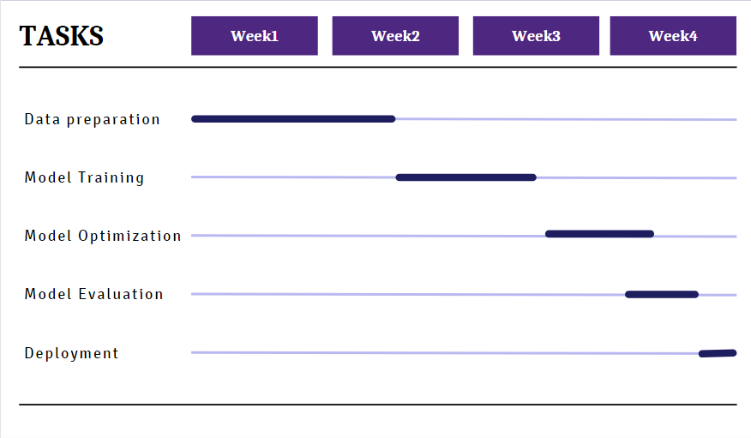
Gantt Chart

Slide 17
Thank You

